Slide 1


PROJECTILE MOTION
-BOUNCING BALL

Slide 2



PROJECTILE MOTION OF BOUNCING BALL
-BY
DEVI PRIYA.G
E0320016
FACULTY: PROF.SATHTA NARAYANA RAJU

Slide 3
AIM
To predict and verify the height of a projectile with various bounces launched at an angle.

Slide 4
THEORY
Galileo discovered Projectile motion.
A projectile is a free-falling object. A projectile experiences negligible or no air resistance. A projectile must be moving in the downward direction. A projectile must be accelerating in the downward direction.
A projectile is any object that once projected or dropped continues in motion by its own inertia and is influenced only by the downward force of gravity.

Slide 5
CHARACTERISTICS OF PROJECTILE
Objects experiencing projectile motion have a constant velocity in the horizontal direction, and a constantly changing velocity in the vertical direction.
The trajectory resulting from this combination always has the shape of a Parabola.
The time required for initially horizontal projectile motion to occur is the same as the time required for the object to fall to its final height.

Slide 6
CODE- PROJECTILE OF BOUNCING BALL WITH VARIOUS BOUNCES ALONG HORIZONTAL AXIS
from math import sqrt
import matplotlib.pyplot as plt
h0 = 5 # m/s
v = 0 # m/s, current velocity
g = 10 # m/s/s
t = 0 # starting time
dt = 0.001 # time step

Slide 7
CODE
rho = 0.75 # coefficient of restitution
tau = 0.10 # contact time for bounce
hmax = h0 # keep track of the maximum height
h = h0
hstop = 0.01 # stop when bounce is less than 1 cm
freefall = True # state: freefall or in contact

Slide 8
CODE
t_last = -sqrt(2*h0/g) # time we would have launched to get to h0 at t=0
vmax = sqrt(2 * hmax * g)
H = []
T = []
while(hmax > hstop):
if(freefall):

Slide 9
CODE
hnew = h + v*dt - 0.5*g*dt*dt
if(hnew<0):
t = t_last + 2*sqrt(2*hmax/g)
freefall = False
t_last = t + tau
h = 0

Slide 10
CODE
else:
t = t + dt
v = v - g*dt
h = hnew
else:
t = t + tau

Slide 11
CODE
vmax = vmax * rho
v = vmax
freefall = True
h = 0
hmax = 0.5*vmax*vmax/g
H.append(h)
T.append(t)

Slide 12
CODE
print("stopped bouncing at t=%.3f\n"%(t))
plt.figure()
plt.plot(T, H)
plt.xlabel('time')
plt.ylabel('height')
plt.title('bouncing ball')

Slide 13
OUTPUT
Stopped bouncing at t=7.762
Text(0.5, 1.0, ‘bouncing ball’)

Slide 14
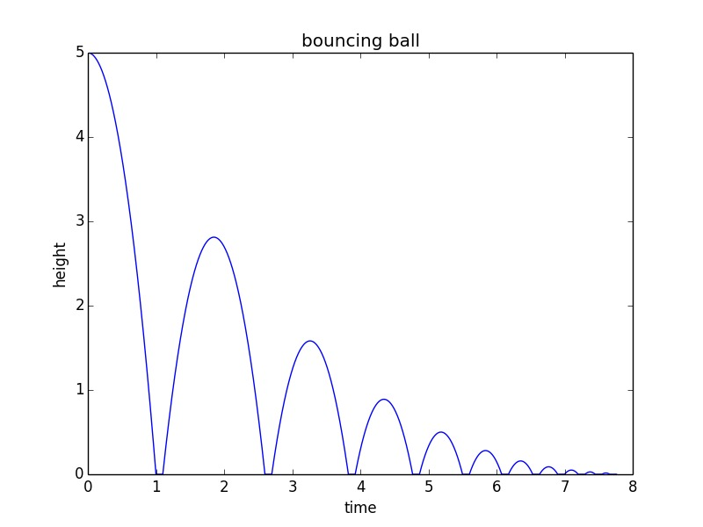
OUTPUT

Slide 15
CODE-PROJECTILE OF BOUNCING BALL IN VERTICAL DIRECTION
GlowScript 3.0 VPython
ball = sphere(pos=vector(0,10,0), radius=1, color=color.red)
floor = box(pos=vector(0,0,0), size = vector(10,0.5,10), color=color.green)
ball.velocity=vector(0,0,0)
dt=0.01
t=0

Slide 16
CODE
g=-9.8
while (t<20):
rate(100)
ball.velocity.y=ball.velocity.y+g*dt
ball.pos=ball.pos+ball.velocity*dt
if ball.pos.y<floor.pos.y+1.25 :
ball.velocity.y = -ball.velocity.y
t=t+dt

Slide 17

OUTPUT

Slide 18

VIDEO

Slide 19
APPLICATION OF PROJECTILE
An object in motion close to the Earth's surface subject to gravitational acceleration, requires an understanding of the physics involved in projectile motion.
Many sports involve the throwing of a ball or other object. The vertical velocity of the projectile gets smaller on the upward path until it reaches the top of the parabola.

Slide 20
THANK YOU

